Slide 1
WNIC
(Wireless Network Instead of Camera)
Seoul Women’s University, Dept. of Information Security
- Jihye Shin / Sohee Won / Seorin Jung

Slide 2
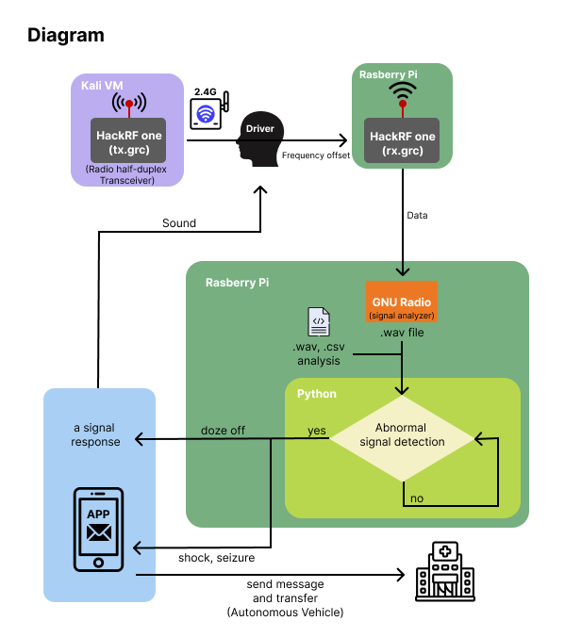
Diagram Explanation
Connect 2 HackRF one (Radio half-duplex Transceiver) using GNU Radio
Repeat the abnormal behavior (nodding of the head) between 2 HackRF one and extract the .wav file
Analyze .wav files using Audacity
Use wav2csv.py to convert .wav files to .csv files and analyze them
Analyze .wav files with Python using Colab
Based on step 5, write anomaly detection code
Use piezo buzzer for the Alarm sound , twilio for text transmission
(signal analyzer)
Girls in ICT 2022

Slide 3

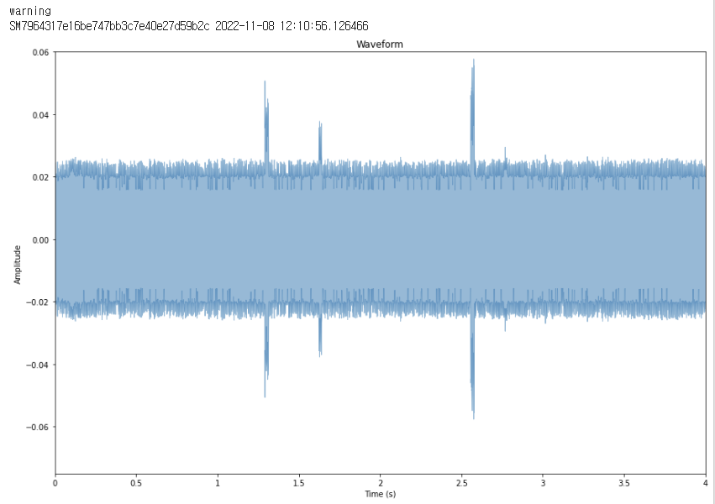
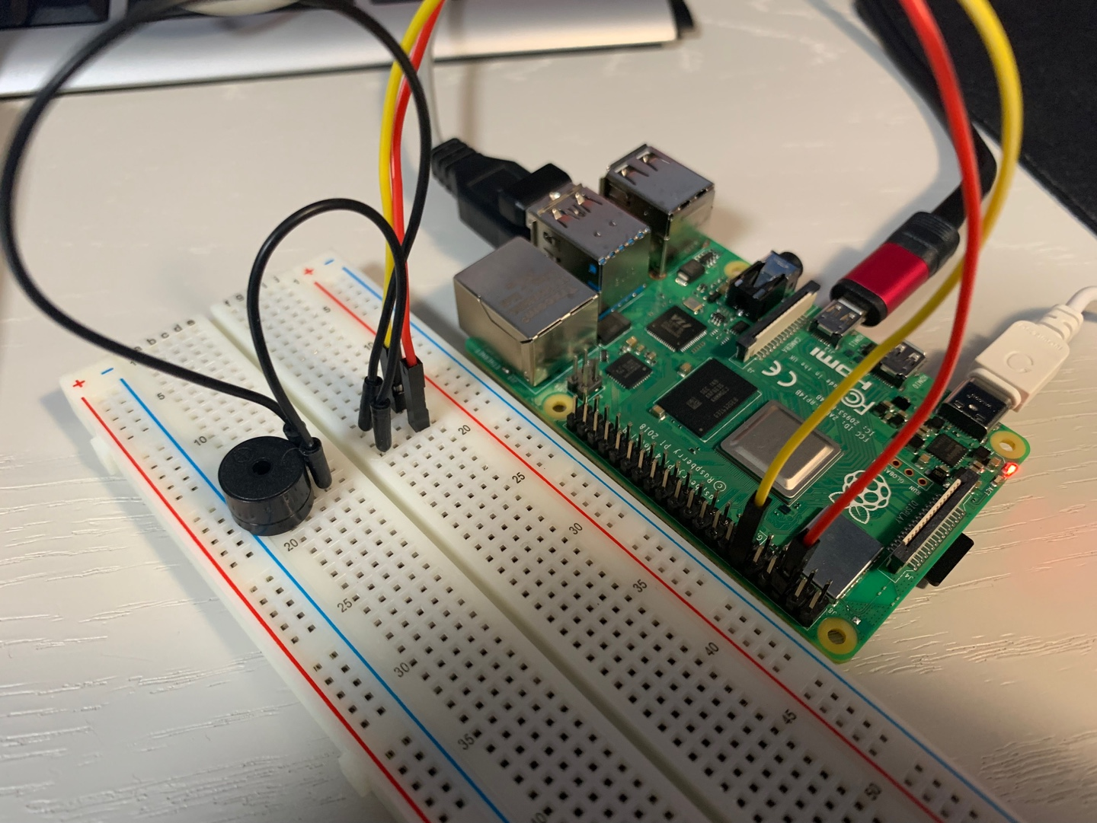
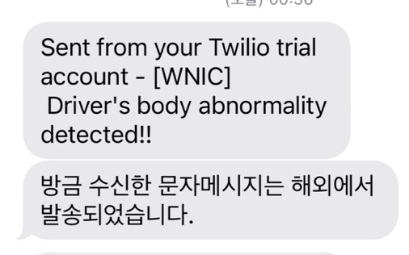
Technology used in 'WNIC'
GNU Radio
file for transmisson: 2.4G Wi-Fi transmission to 'osmocom sink'
file for receving : Receive the Wi-Fi frequency changed by behavior as 'wav file sink'
Visualize wav with Python code
When a frequency of 0.04 or more was detected, the detection message was coded to appear.
In addition, rules were analyzed using FFT, STFT, and MFCC.
Behavior | O | X
Frequency range | -0.02~0.02 | -0.04~0.04
CSV files were converted to analyze .wav files as numerical data.
python wav2csv.py
Display SOS -> piezo buzzer, sending message
An alarm for notifying the driver that an abnormality is detected in the vehicle is output.
Twilio was used to send sms from Raspberry to smartphone to specific destinations (911, 112).
Girls in ICT 2022

Slide 4


Why ‘WNIC’ technology is needed
Benefits of WNIC Technology
The level of personal information and privacy infringement is lower than that of using a camera. In addition, the behavioral recognition rate is higher when frequency is used than the camera in the absence of light.
Currently, autonomous driving technology is two to three out of five stages, which can reduce traffic accidents caused by physical abnormalities such as fainting and seizures of drivers and traffic accidents caused by carelessness of drivers.
Potential for development
When developing heart rate measurement using frequency, it is predicted that frequency files can be forensics to reveal the cause of automobile accidents.
When the SOS text is transmitted to 911 and 112 at the real-time location of the driver, it is possible to prevent a driver accident.
When developing into stages 4 to 5 of autonomous driving, our technology can be introduced and developed into a technology that transports the driver's vehicle to the nearest hospital.
Girls in ICT 2022

